Slide 1

BAN440 – Term Paper Idea
Group 3: Øyvind Odland, Sander Eriksen, William Eide

Slide 2
Agenda
Description of data
Topic/Question
Empirical model

Slide 3

What is Vinmonopolet?
Monopoly on retail sale of alcoholic beverages above 4.7%
No profit motive – the state earns money on taxes and fees
Controlled distribution and availability
Covers 98% of the population within 30km

Slide 4
Data(gathering)

Slide 5
Main data set
2024 data
Total sales (liters) per store
There is also data for each alcohol type
Individual store data
Location name
Geo-location
Municipality(?)
Store type (size and sortiment)

Slide 6
Merged data
Municipality data (area, population)
Grensehandel (calculated spending on day trips abroad)
Tourism (Number of stays in a municipality)
Distance (municipality admin centers – store locations)

Slide 7
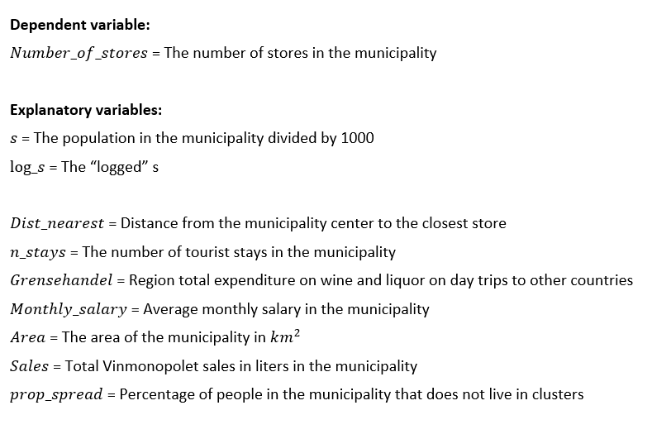
Variables

Slide 8
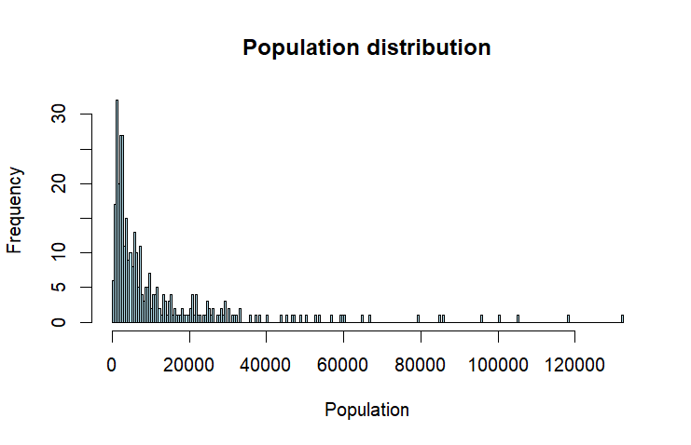

Population distribution (except 4 largest cities)
Which limit should we set?
150 000? 100 000? 80 000?

Slide 9
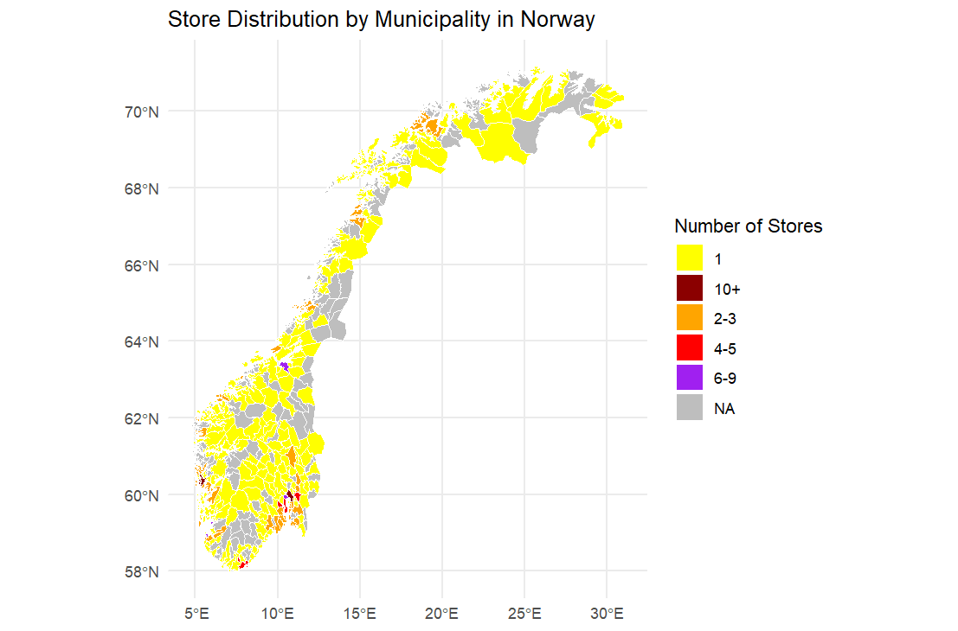
Stores by municipalities
Key takeaways:
A lot of municipals with 1 store
Some areas with multiple no-store-municipals.
Big number heavily centered around big cities

Slide 10
Topic / Research Question

Slide 11
Research question
We need feedback on this, but we have some suggestions:
Can market entry models assist Vinmonopolet in deciding on their next store location?
What is the minimum market size required to support different numbers of Vinmonopolet stores, and how do these thresholds change as the number of stores increases?
To what extent does the presence of cross-border shopping opportunities affect entry thresholds for Vinmonopolet stores in border regions, and how should this inform store placement policies?

Slide 12
Empirical model
Are we using the right one?

Slide 13
Empirical model: Bresnahan & Reiss
The alcohol market in Norway violates some of the assumptions of the B&R framework
Could we still use it, or parts of it?
Modify to reflect policy instead of profit

Slide 14
Showcasing some results

Slide 15
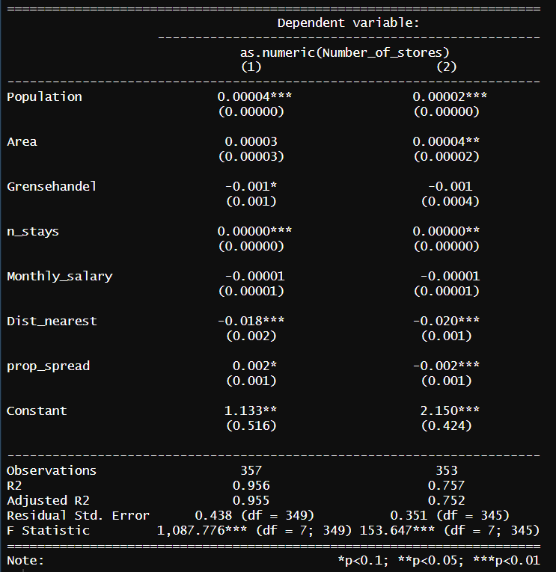
Linear regression, full and constricted data
R^2 decreases significantly after removing the 4 largest cities
Variables other than population can have an effect
Tourism has a positive significant effect
Scale data?

Slide 16
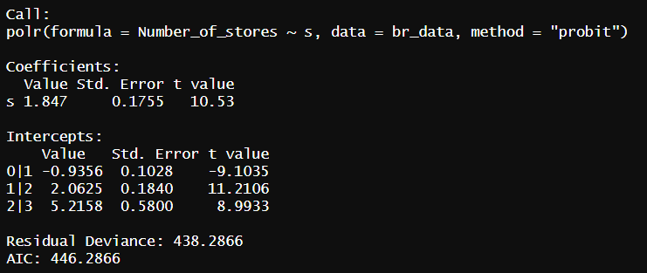
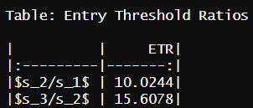
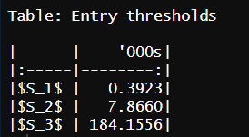
Model 1: pop < 150 000

Slide 17
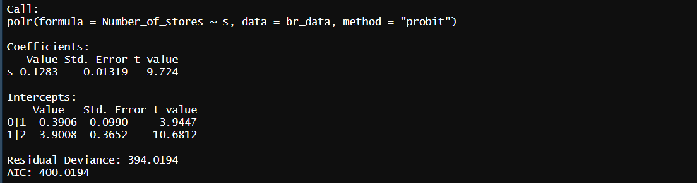
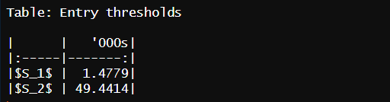
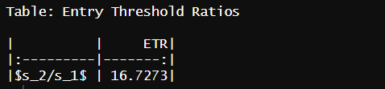
Model 1: pop < 80 000

Slide 18
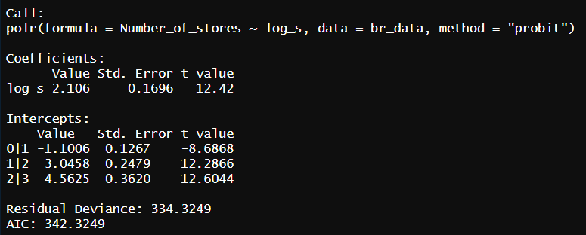
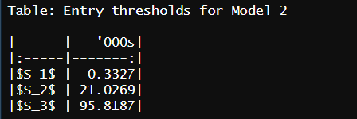
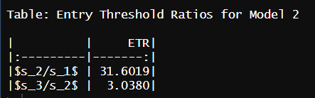
Model 2: pop < 150 000

Slide 19
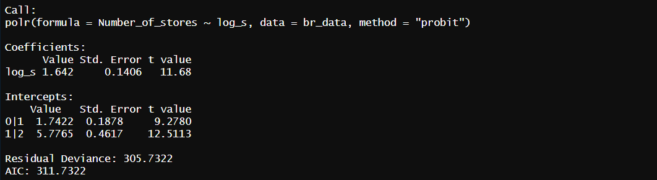
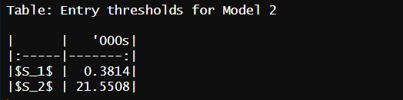
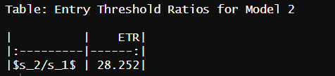
Model 2: pop < 80 000

Slide 20
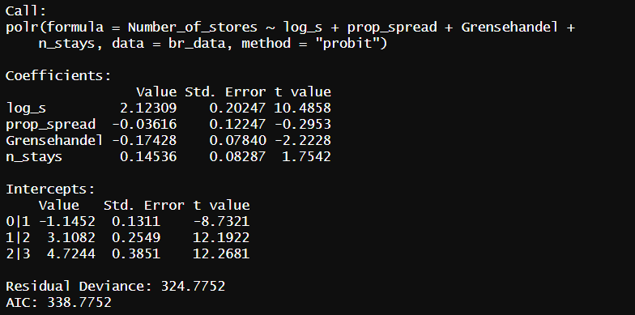
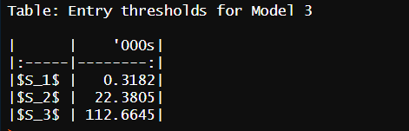
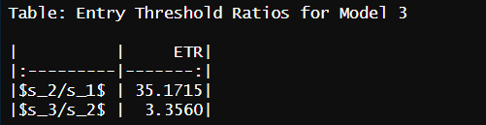
Model 3: pop < 150 000

Slide 21
Difficulties
Population as an independendt variable is too powerful
Almost 97% in raw correlation between n_stores and population
0 values for tourism
Some models will not run because of «too good» fit
Any way to get hold of retail sales as a better estimate for market size?

Slide 22
Questions
Is the B&R framework feasible?
Would it be better with a different approach? Which?
What is the best way to make use of the estimated entry thresholds?
Heavily linked to research question
Are there better variables for our model?
i.e. retail sales volume – where to find?

